Slide 1
Expanding the Open Source Ecosystem around Data.table in R Doris Amoakohene, MSc. Toby Hocking, Professor

Slide 2
Who am I
Personal
I am Doris Amoakohene Afriyie
Experience
Graduate Research Assistant– Northern Arizona University(Aug 2023 - present
Project
Expanding the Open source ecosystem around data.table in R
Education
-Msc. Informatics
Interests
I have been using R since 2018
Using data.table since 2021, but very efficiently from 2023

Slide 3
The Goals For This Project
Modify atime compare-data.table-tidyverse vignette, and analyze efficiency of packages such as polars, arrow, collapse, spark.
Examine the history of data.table repository, including issues about performance regressions, to create two relevant performance tests, and use atime to analyze three different code branches (before regression, regression, fix regression).
Fork data.table, and create github action for performance testing, which is run for every Pull request.
Create slides and present results in machine learning group meeting

Slide 4
Overview of Presentation
What is Data.table? History of data.table Repository
atime and its importance in performing this analysis
Overview of Packages to be examined(Polars, arrow, collapse, spark in R)
Conclusion

Slide 5
What is Data.table? History of data.table Repository

Slide 6
What is Data.table? History of data.table Repository
Data.table is a powerful R package that provides an enhanced version of the traditional data.frame object. It is designed for efficient data manipulation, particularly for large datasets.
DT
 | Id | val
1 | d | 3
2 | c | 5
3 | f | 6
4 | s | 7
5 | s | 1
6 | a | 4
Data.table has more powerful R code syntax, and C code implementation
R package on CRAN since 2006
Created by Matt Dowle, co-author Arun Srinivasan since 2013, 50+ contributors
1463 other CRAN packages require data.table (in most popular 0.05% of all CRAN packages, rank 11/19932 as of 1 Oct 2023)
(source:TobyPresentation slide)

Slide 7
Comparing Data.table and Data Frame
Similarities | data.table | data.frame
Tabular Data Structure | Yes | Yes
Data Manipulation | Yes | Yes
Column Naming | Yes | Yes
Column Types | Numeric, Character, Logical, Factors, and more | Numeric, Character, Logical, Factors, and more
Data Analysis | Yes | Yes
Integration | Can be used together within the same code or project | Can be used together within the same code
Differences | data.table | data.frame
Performance | Efficient for large datasets | May be slower for large datasets
Syntax | Concise and expressive | Traditional R syntax
Memory usage | Uses less memory | May use more memory
Compatibility | Compatible with most R functions and packages | Widely used default data structure in R
Additional features | Advanced join operations, fast grouping and aggregating functions, modify data by reference | Standard functionality without specialized features

Slide 8
Compare Data.table and Tidyverse
Similarities | data.table | tidyverse
Data Manipulation | Yes | Yes
Tabular Data Structure | Yes | Yes
Column Naming | Yes | Yes
Data Analysis | Yes | Yes
Integration | Can be used together within the same code or project | Can be used together
Differences | data.table | tidyverse
Syntax | Specific syntax unique to "data.table" | Consistent syntax across "dplyr," "tidyr," and other packages
Performance | Optimized for large datasets | May be slower for large datasets
Memory usage | Uses less memory | May use more memory
Additional features | Advanced join operations, modify data by reference | Wide range of packages for data manipulation and analysis

Slide 9
atime and its importance in performing this analysis

Slide 10
atime for Performance Efficiency
What is atime
What is atime use for?
Key Function
It has features used for measuring asymptotic memory usage and other quantities.
Measuring and comparing the execution times of various expressions or functions for different data sizes. Users can gain insights into the scalability and efficiency of their code.
The key function provided by the 'atime' package is called atime().
This function allows users to specify a numeric vector of data sizes (N) and an expression or a list of expressions (expr.list) to be timed
The atime package in R is designed to facilitate the computation and visualization of comparative asymptotic timings of different algorithms and code versions.
It offers functionality for comparing empirical timings with expected references based on asymptotic computational complexity.

Slide 11
atime importance in performing this analysis
Compare the performance of these packages in terms of their speed, memory usage using the atime
When assessing the efficiency and performance of these packages, it is important to consider that they can vary depending on factors such as the nature of the dataset, available hardware resources, and specific use cases. In this context, utilizing the atime metric will greatly assist us in accurately determining these variations.

Slide 12
Overview of Packages to be examined

Slide 13
Packages
Polars
Polars is a fast and efficient data manipulation and analysis library for R.
It provides a DataFrame API similar to pandas in Python and allows you to perform operations like filtering, aggregating, joining, and transforming data.
Polars is designed for working with large datasets and utilizes parallel processing to achieve high performance.
spark
The sparklyr package provides an R interface to Apache Spark, a distributed computing system.
Spark is known for its ability to process large-scale data sets in a distributed and parallel manner.
Collapse
The collapse package provides various functions for aggregating and collapsing data in R.
It includes functions for collapsing data by group, creating contingency tables, calculating summary statistics, and performing other data aggregation tasks.
The package aims to provide efficient and convenient methods for summarizing data.

Slide 14
Packages
Dplyr
dplyr is a widely used package for data manipulation in R.
It provides a set of functions that allow you to easily filter, arrange, mutate, and summarize data. dplyr follows a "grammar of data manipulation" approach, which means that it provides a consistent and intuitive syntax for performing common data manipulation tasks..
tidyr
tidyr is another popular package for data manipulation in R.
It focuses on transforming data between "wide" and "long" formats, also known as data reshaping or tidying. tidyr provides functions like pivot-longer and pivot wider that help you reshape your data to a more suitable format for analysis
Reshape2
reshape2 is an older package in R that provides functions for reshaping and transforming data.
It offers tools for converting data between different formats, such as converting data from wide to long format or vice versa.

Slide 15
Plot showing analyzes of efficiency of data.table and packages

Slide 16
Analyzing Performance Regressions( Before, Regression and Fix)
Identify Performance Issues
Creating relevant performance tests allows you to set benchmarks and measure the performance of the system under various conditions.
Validate Fixes
Maintain User Satisfaction
Future Performance Monitoring

Slide 17
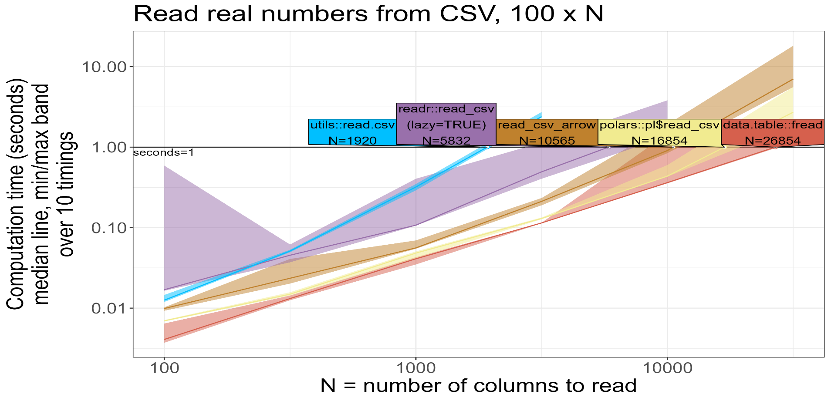
Reading CSV Files in R

Slide 18
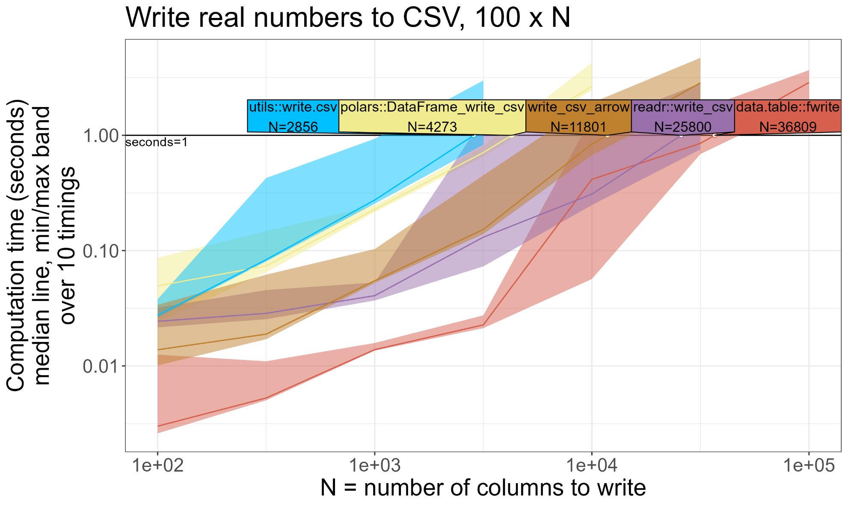
Writing CSV Files in R

Slide 19
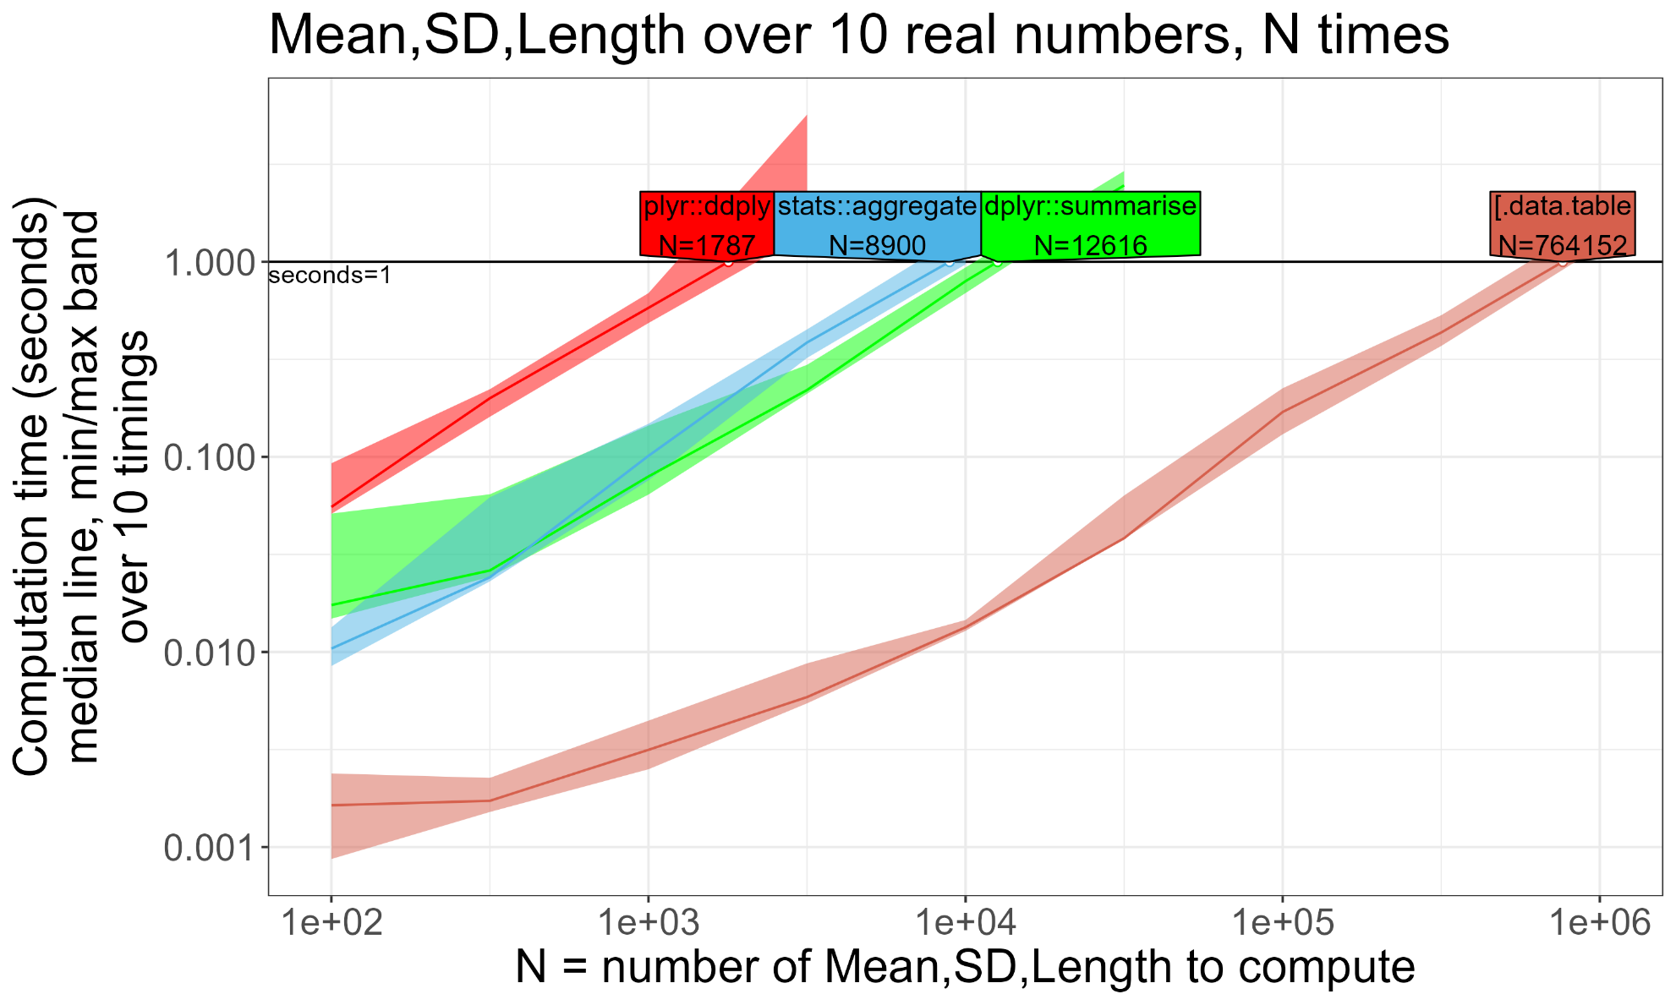
Creating Data Summary in R

Slide 20
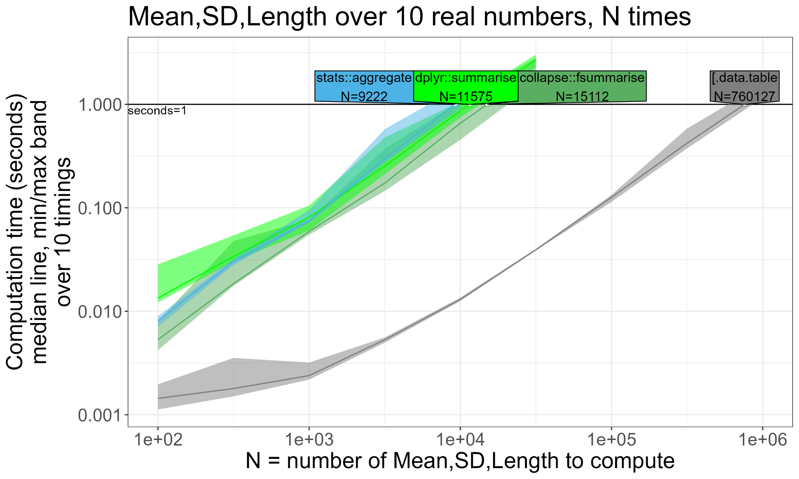
Creating an Expanded Data summary in R

Slide 21
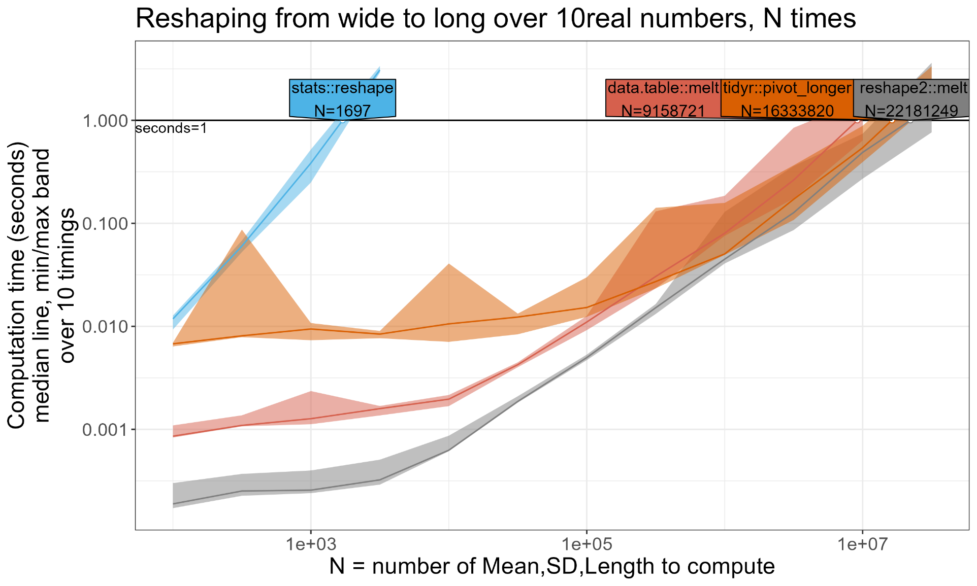
Reshaping Data from wide to long format

Slide 22
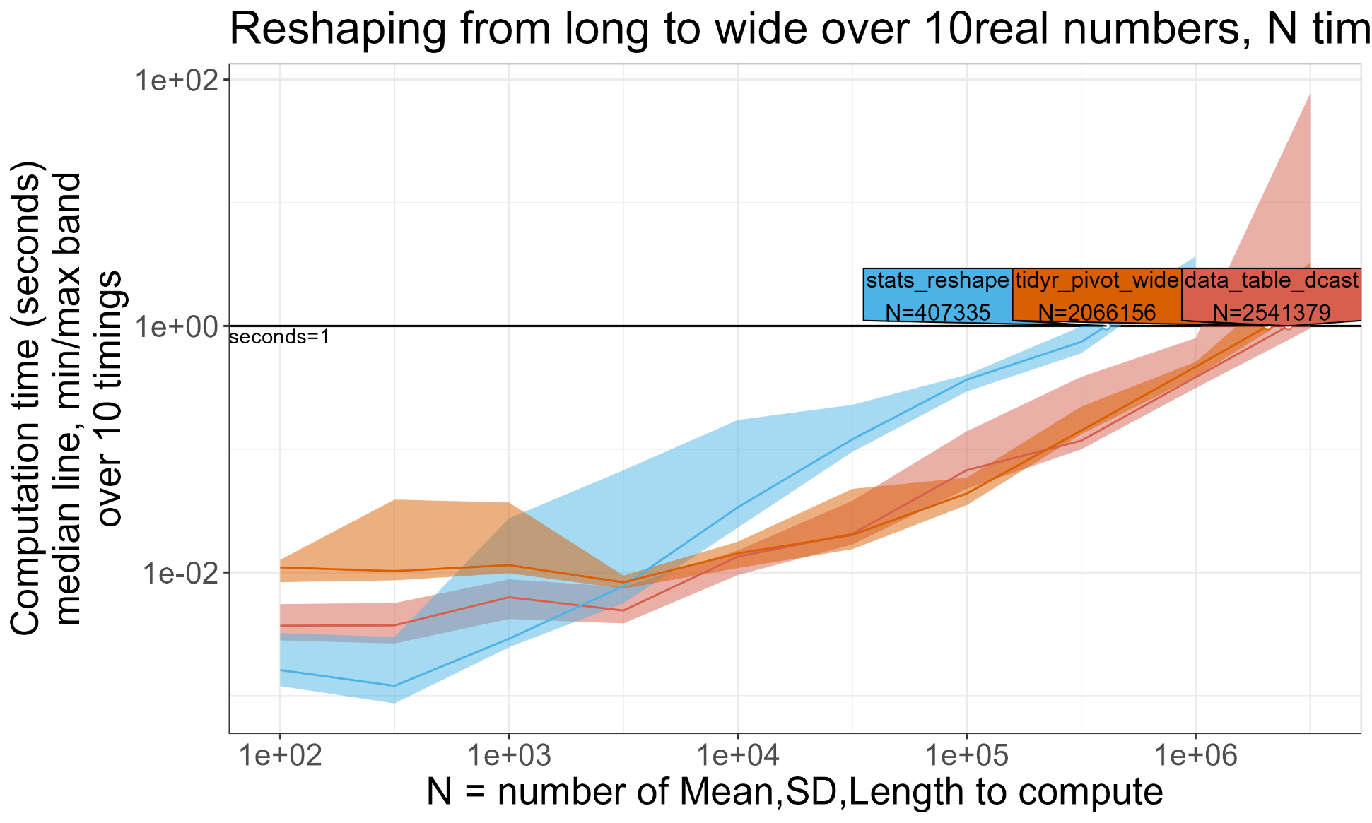
Reshaping Data from Long to wide Format in R

Slide 23
Performance Regression on Github Issues

Slide 24
Comparing the efficiency of the data.table package with other packages is important for several reasons:
Performance Optimization: Efficiency comparisons help identify the most efficient package for handling large datasets and performing complex operations.
Decision-making: By comparing the efficiency of data.table with other packages, you can make informed decisions about which package to use for specific tasks
Compatibility and Integration: Understanding the efficiency of different packages helps you assess their compatibility with your existing codebase, libraries, and dependencies
Benchmarking and Reproducibility: Efficiency comparisons enable benchmarking, allowing you to measure the performance of different packages objectively. This helps researchers, developers, and data scientists reproduce experiments, validate results, and ensure consistency across different analyses.

Slide 25
groupby with dogroups (R expression) performance regression #4200
This issue reported a performance regression when performing group computations, specifically when running R's C eval on each group (q7 and q8) in the db-benchmark, indicating a slowness in the implementation of the code.
Regression: The regression was specifically related to the evaluation of C code within each group of data, specifically q7 and q8 in the "db-benchmark“
Fixes Regression: The Regression was fixed : The regression was fixed Regression by the addition of const int nth = getDTthreads

Slide 26
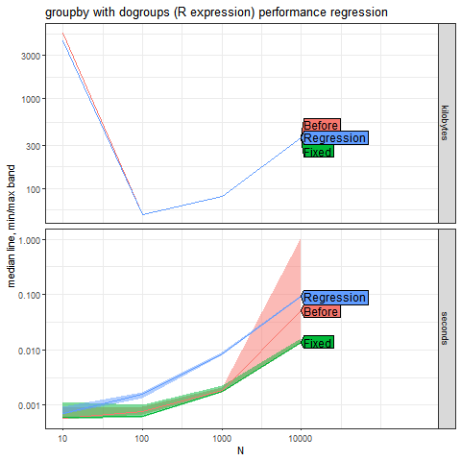
groupby with dogroups (R expression) performance regression #4200

Slide 27
Significantly slower performance time-based rolling and issue5371
The cause of the regression is related to the addition of the snprintf function in the assign.c.
Regression: The regression was specifically related to significantly slower performance time-based rolling
Fixes Regression: The Regression was fixed by creating targetDesc function and adding snprintf in assign.c

Slide 28
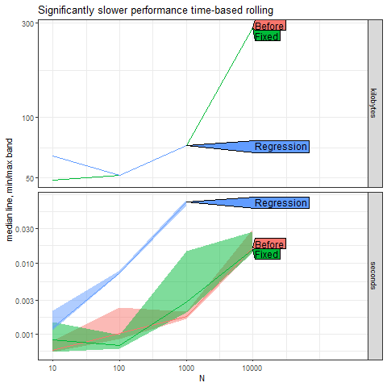
Plot

Slide 29
Remove deep copy of indices from shallow
This issue reported that when using the dt[selector, foo := bar] syntax with an index defined, the performance of that operation can be significantly slower compared to when there is no index.
Regression: The regression was Remove deep copy of indices from shallow slow
Fixes Regression: The Regression was fixed by passing shallow(dt.s4) to the isS4() function

Slide 30
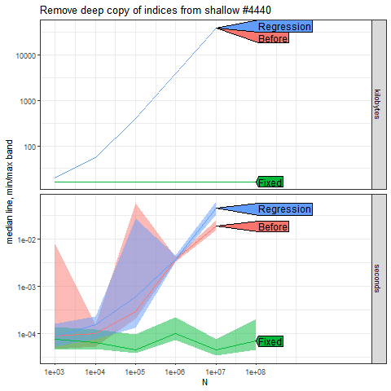
Plot

Slide 31
CONCLUSION
data.table has a strong track record as a high-performance package for data manipulation.
It excels in tasks such as reading and writing CSV files, grouping data, and reshaping data between wide and long formats.
data.table demonstrates responsiveness when it comes to addressing and resolving performance-related issues, actively engaging in discussions and providing timely fixes.

Slide 32
Thank You!!!

